Slide 1
AI ENABLED WEED RECOGNITION SYSTEM
SMART BRIDGE-REMOTE SUMMER INTERNSHIP PROGRAM
DEVELOPED BY-
Chandana Laxmi H
Arpita Telkar
Pooja Y U
Rooja Devina
Nikita G Ghante

Slide 2
Introduction
Weeds have a devastating impact on crop production and yield in general. Current practice uses uniform application of herbicides leading to high costs and degradation of the environment and the field productivity.
The identification and classification of weeds are of major technical and economical importance in the agricultural industry.
Deep learning method has been proposed in our project which identifies the weed among the crops with the help of CNN.
CNN is used to classify the images based on the method of feature extraction. It detects the weed if present in the image classifies it. The dataset used in this project is the collection of several crops and the weeds.

Slide 3
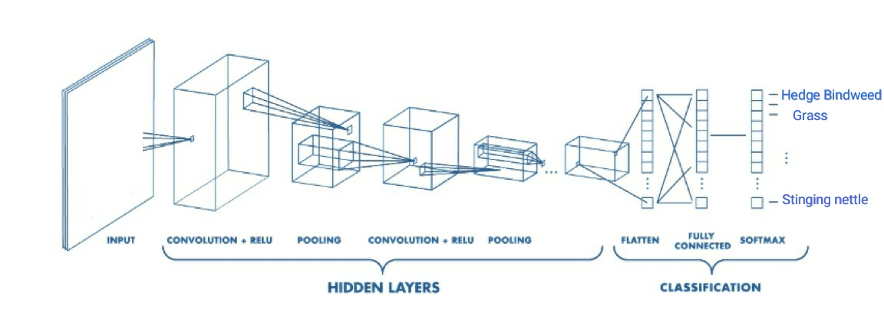
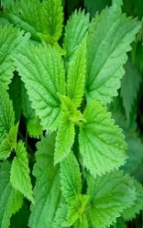
CNN Layers

Slide 4
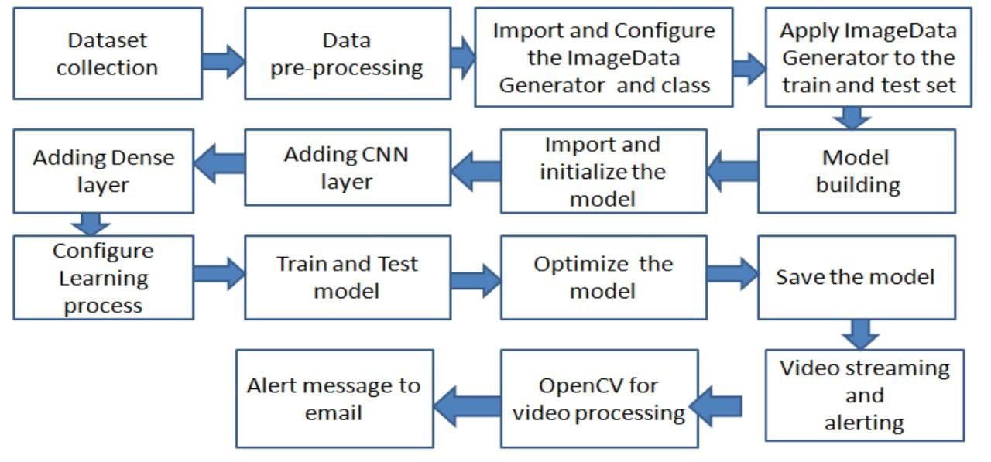
Block Diagram

Slide 5
Software Designing
Jupyter Notebook Environment
Spyder IDE
Python (pandas, numpy, Keras,Tensorflow,ImageDataGenerator, Model Building, CNN Layers)
HTML,CSS,JS
Flask Framework
We developed this weed recognition system by using the Python language which is an interpreted and high level programming language and using the Convolution neural network. For coding we used the Jupyter Notebook environment of the Anaconda distributions and the Spyder, it is an integrated scientiﬁc programming in the python language. For creating an user interface for the prediction we used the Flask framework. It is a micro web framework written in Python. s

Slide 6
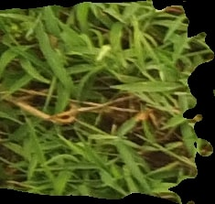
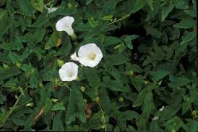
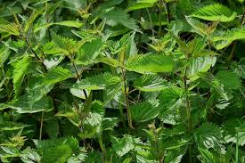
Experimental Analysis
In this project we have created a dataset with a collection of different types of weeds that commonly grow with the crops. Sample images of weed dataset is given below.
The set of weeds that we have trained to this model are Crab grass, hedge bindweed and stinging nettle respectively.

Slide 7
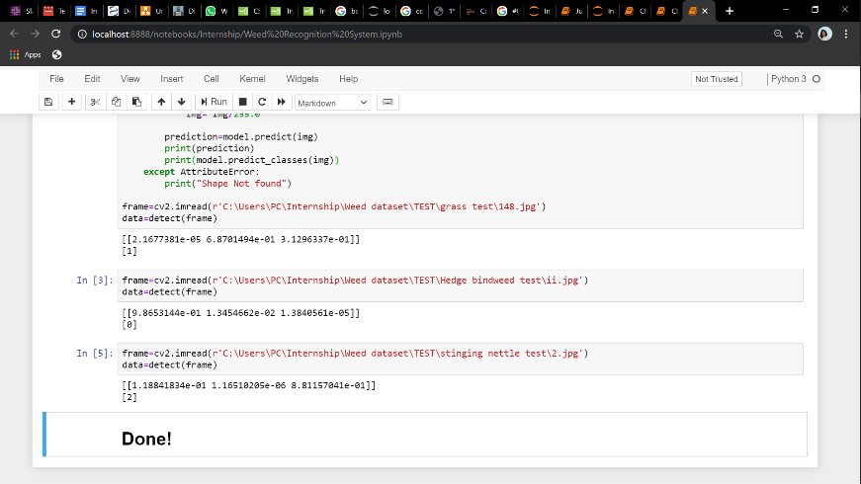
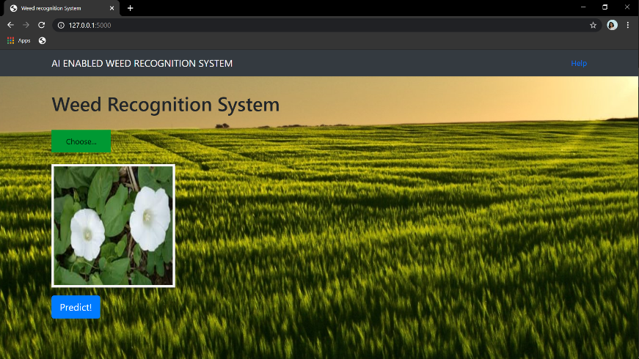
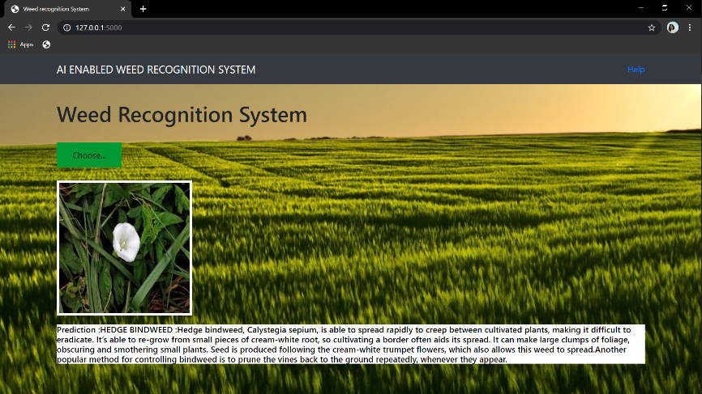
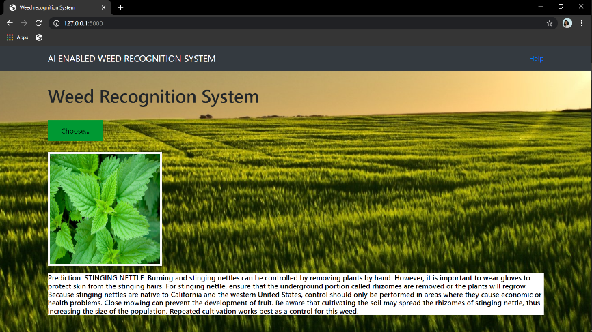
Result
After training the model and building the flask application to predict the type of weed. The outputs are generated as follows
(a) Program output for weed detection
(b)Output after selecting the test image
(c)Output prediction of Hedge bindweed and its description
(d)Output prediction of Stinging nettle weed and its description

Slide 8
Applications
Weed recognition can be a useful system in detecting the weeds among the crops in the farm.
Our system is more typically useful for the detection of types of weed grown anywhere. This helps every individual make sure of their crop’s nutrients.
Weed detection using Deep Learning is a game-changer as it allows us to significantly cut the time spent on manual work and the cost of it.

Slide 9
Advantages
Allows crops to grow in a weed free environment or with minimum competition during their tender and seedling stage.
Weed killers, known as herbicides, aid in controlling unwanted plants, but the chemicals come with unpleasant and sometimes dangerous side effects. Our system recognizes the weed from the crop and has no side effects on the crop.
Reduces the manual work of farmers to go in search of weeds once the crops are germinated.
Disadvantages
This system must be used on regular intervals to remove the weeds regularly from the farm.
Some hidden weeds are not recognizable by the system. This way, our system cannot accomplish its task perfectly.
Requires video capturing systems which may not be affordable

Slide 10
Conclusion
The developed model has the potential to be deployed on an embedded mobile platform like the Jetson TX for online weed detection and management due to its high-speed inference.
It is recommendable to use synthetic images and empirical field images together in training stage to improve the performance of models.
This project demonstrated the feasibility of using CNN for weed detection in different weeds. When the neural networks were trained using training datasets containing a three weed species, it performed well to recognize each variety of weed and can be extended to many number of weeds that grow with the crops in agricultural lands.

Slide 11
THANK YOU

